Slide 1
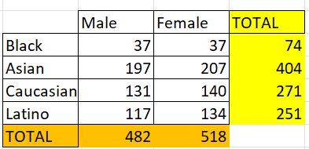
Ques1
There are 1000 employees in the company and here above is the distribution based on gender and Ethnicity where the Asians are highest

Slide 2
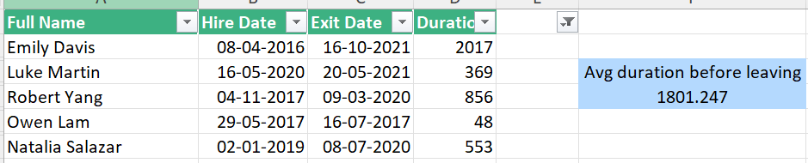
Ques2
Avg employee stays for 1801 days before leaving

Slide 3
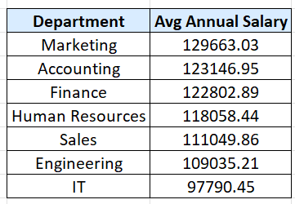
Ques3
Here Is the avg salaraies of different depts and we can see that highest avg salary is of marketing dept while the lowest is of IT dept. But there is not a much significant difference between others

Slide 4
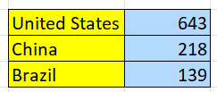
Ques4
highest number of employees are from USA followed by China and Brazil

Slide 5
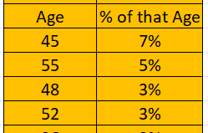
Ques5
7% employees are of 15 age and 5% are of 55

Slide 6

Ques6
IF we talk about people only who receives bonus then it is around 18.78%

Slide 7
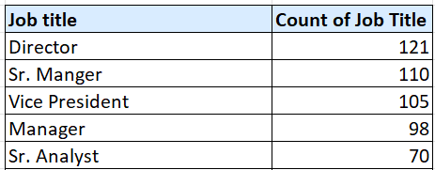
Ques7
Director as a title occurs most frequently

Slide 8
Ques8

Slide 9
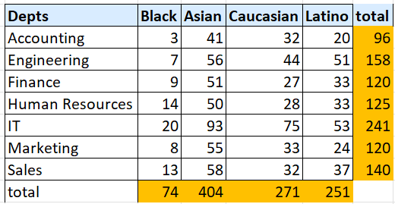
Ques9
By ethnicity Asians are the highest which are almost equal in all the depts

Slide 10
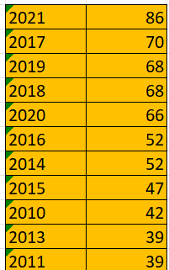
Ques10
In last few years there are more hiring

